Slide 1
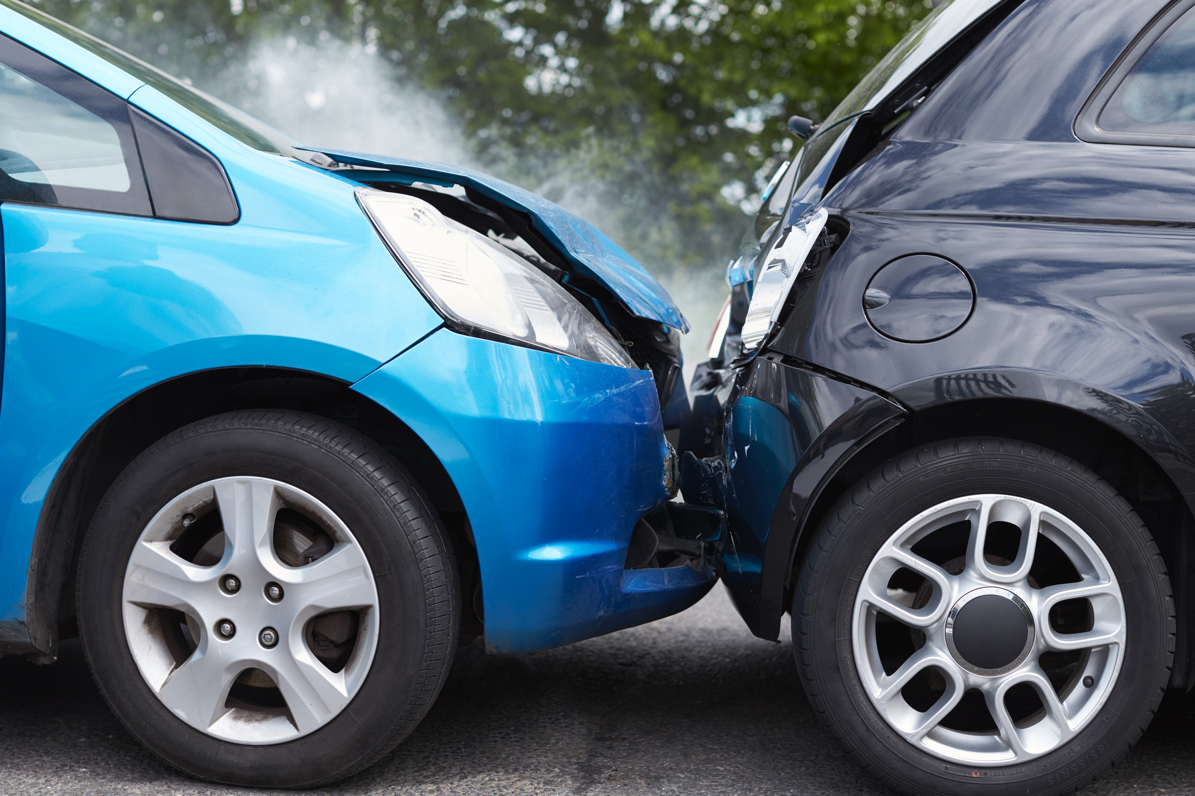

Consequences of collisions

Slide 2
Homework
What hazards did you identify on your journey to or from school?

Slide 3
Let’s watch a video
This (edited) video lasts approximately 5 minutes
It follows a fatal road collision in 2021
A lorry did not brake, and hit a queue of static traffic
3 people were killed

Slide 4


Slide 5
How do you feel?

Slide 6
How many people are impacted by this incident?

Slide 7
Consequences last a lifetime

Slide 8
The good news...
Young people who do the Pathfinder course are FOUR times safer than their peers (1 in 20 compared to 1 in 5 are likely to have any kind of road safety incident in their first 2 years of driving)
You are much less likely to be subject to attention from Roads Policing

Slide 9
Strategies for avoiding collisions
Avoiding distracted driving
Obey speed limits
Never driving under the influence of alcohol or drugs
Using seat belts and child safety seats
Adhering to road signs and signals
Learning good driving practice

Slide 10
Thank you for listening

