Slide 1
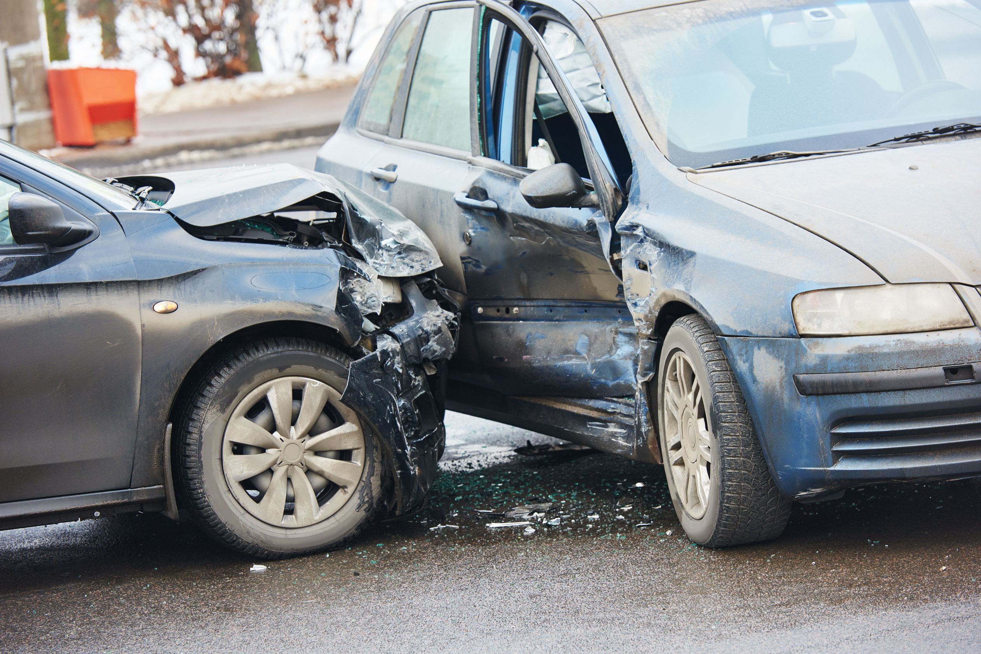

Causes of Collisions

Slide 2
Why are we here?
How many casualties on the UK roads in 2023?
  132,977 casualties (of all severities)
  Reduction of 2% compared to 2022
  29,711 Killed or Seriously Injured (KSI)
How many road fatalities were there in 2023?
  1,624 deaths
  Reduction of 5% compared to 2022

Slide 3
Why are we here?
What percentage of the UK driving population is aged between 17 and 29?
  12.7% have full driving licences
What percentage of the fatalities & casualties on UK roads involve 17–29 drivers?
  23% fatalities – 29% casualties
Why are young drivers such a high risk?

Slide 4
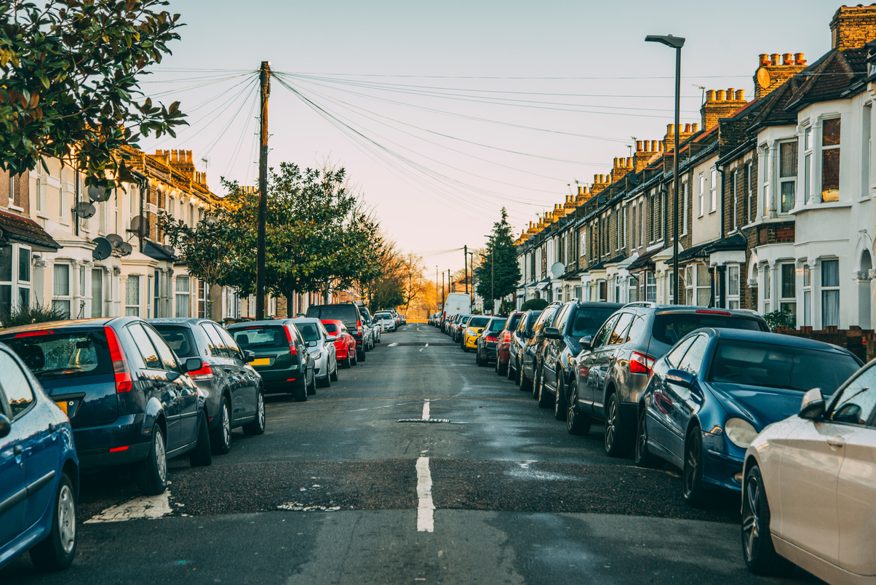
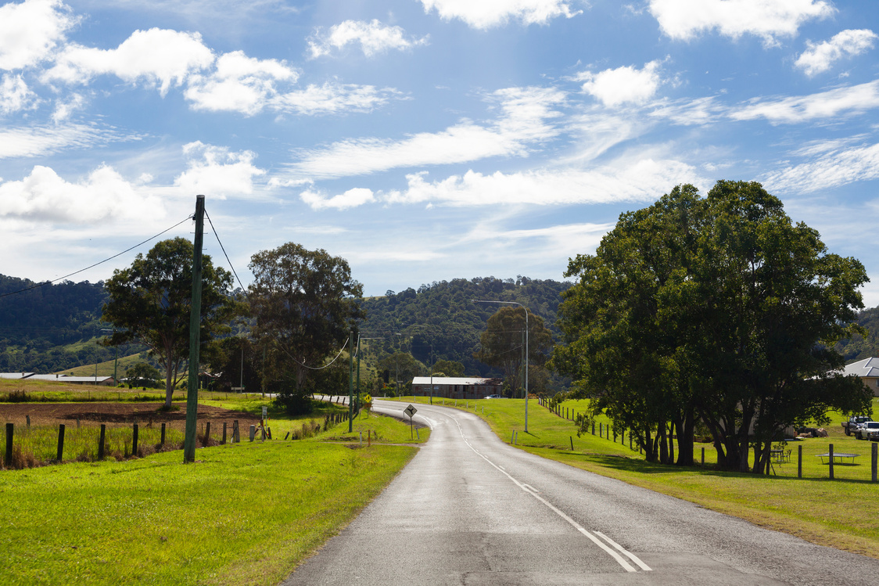
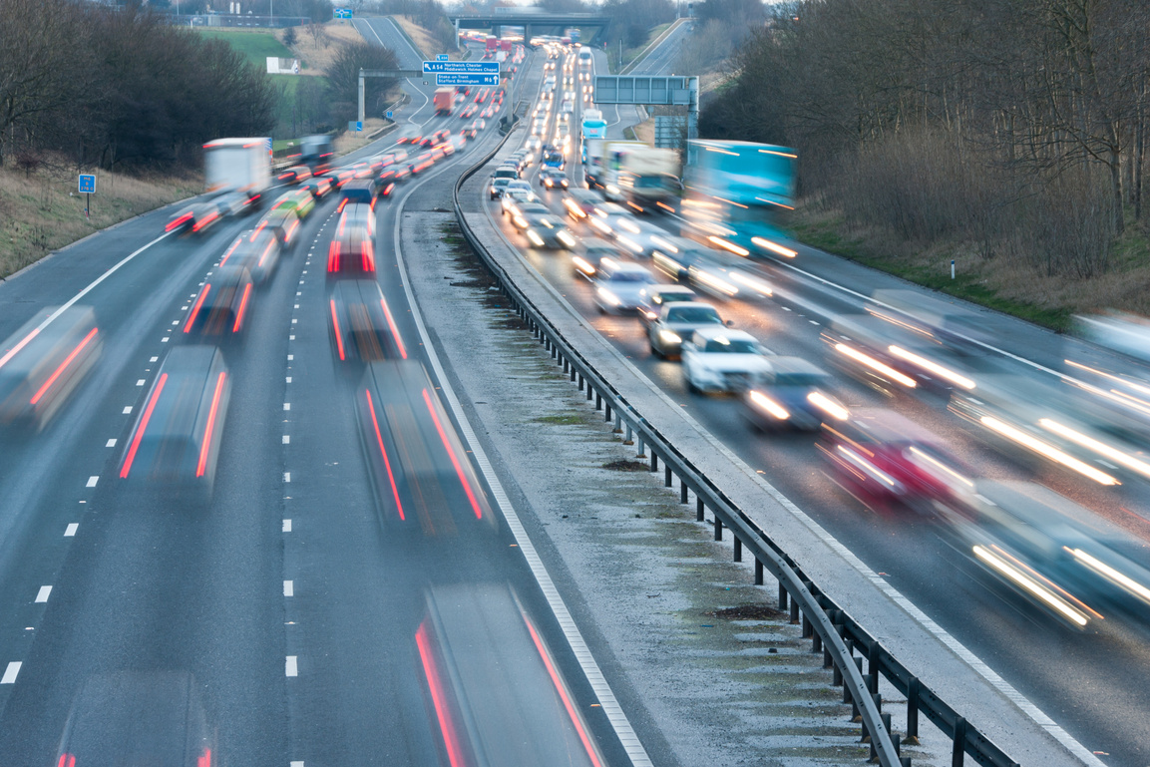
Where do collisions happen?
Percentages of overall UK road network (247,800 miles) by road type
Urban Roads
Rural Roads
Motorways
29%
60%
11%
Collisions
Collisions
Collisions
63%
33%
4%
Fatalities
Fatalities
Fatalities
35%
60%
5%

Slide 5
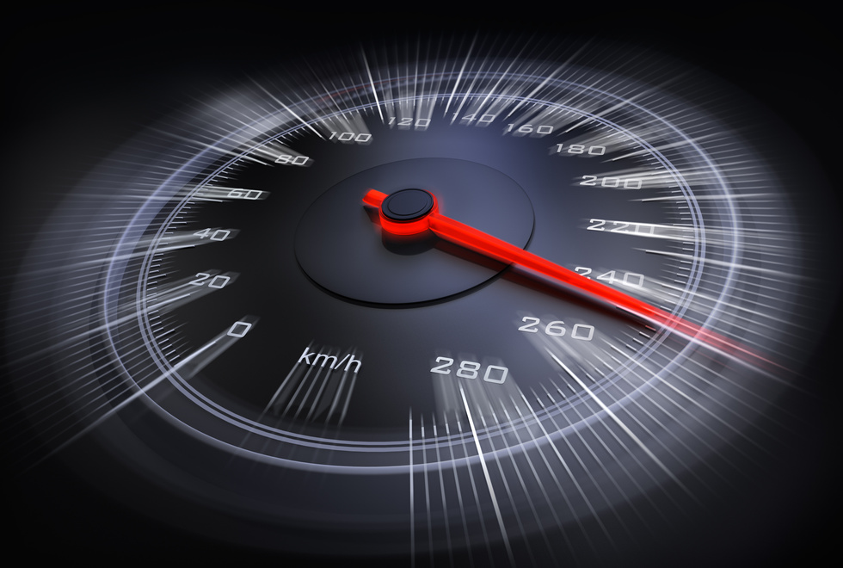
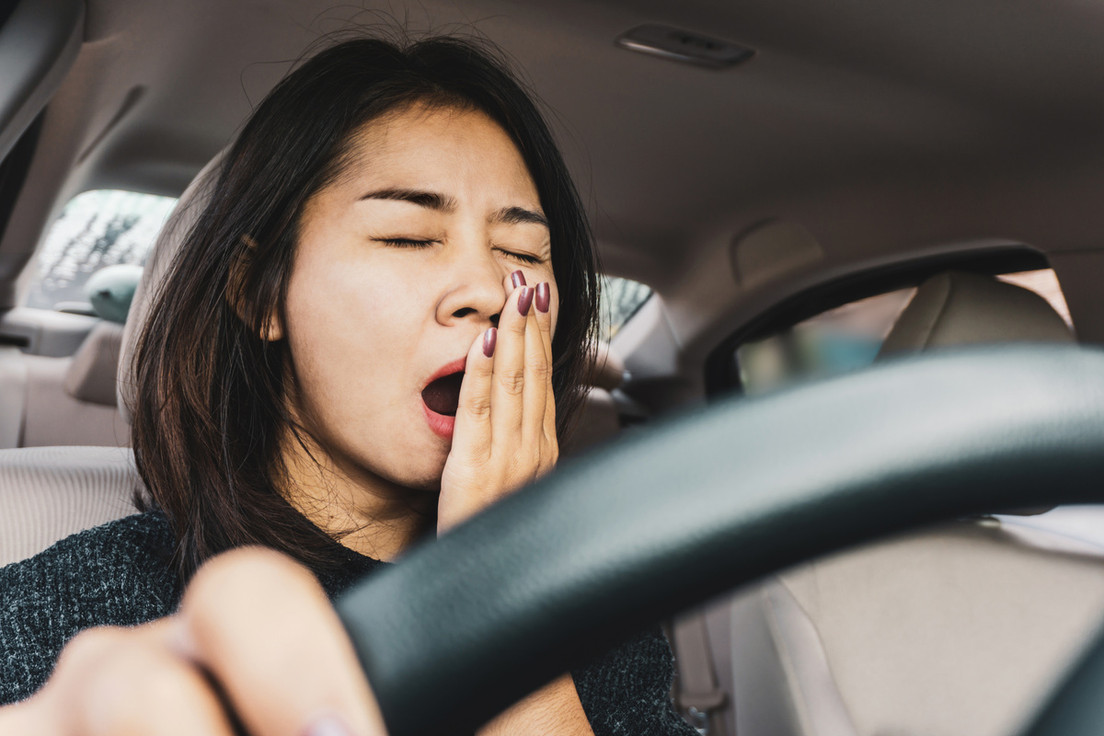


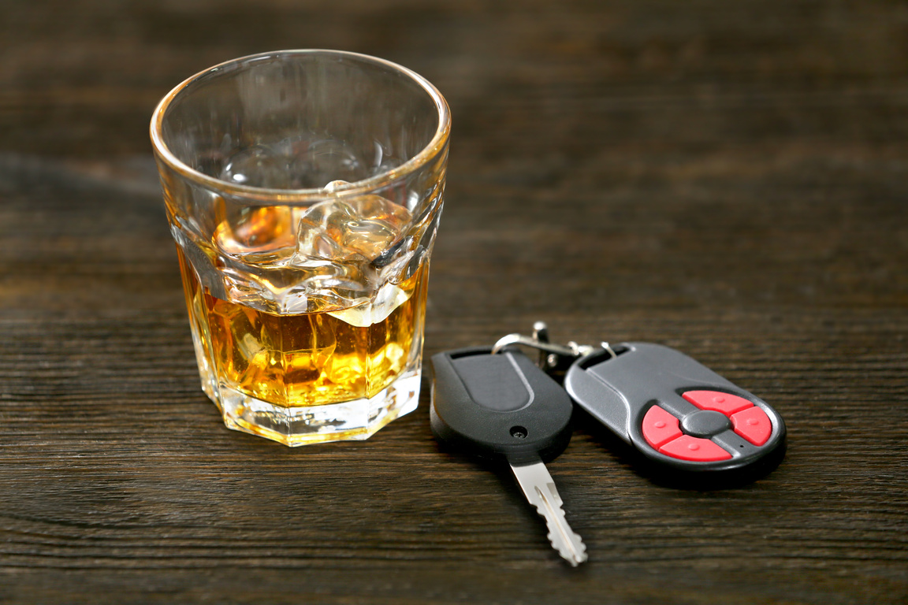
Common causes of RTCs
Speed
Fatigue
THE FATAL
FOUR
Distraction
Drink/Drugs

Slide 6
Speed - A little bit of maths…
  The energy a vehicle possesses (kinetic energy) increases with the square of its speed.
  A vehicle doubling its speed has four times as much kinetic energy.
  A vehicle travelling TWICE as fast as another requires FOUR times the stopping distance (assuming a constant braking force).

Slide 7
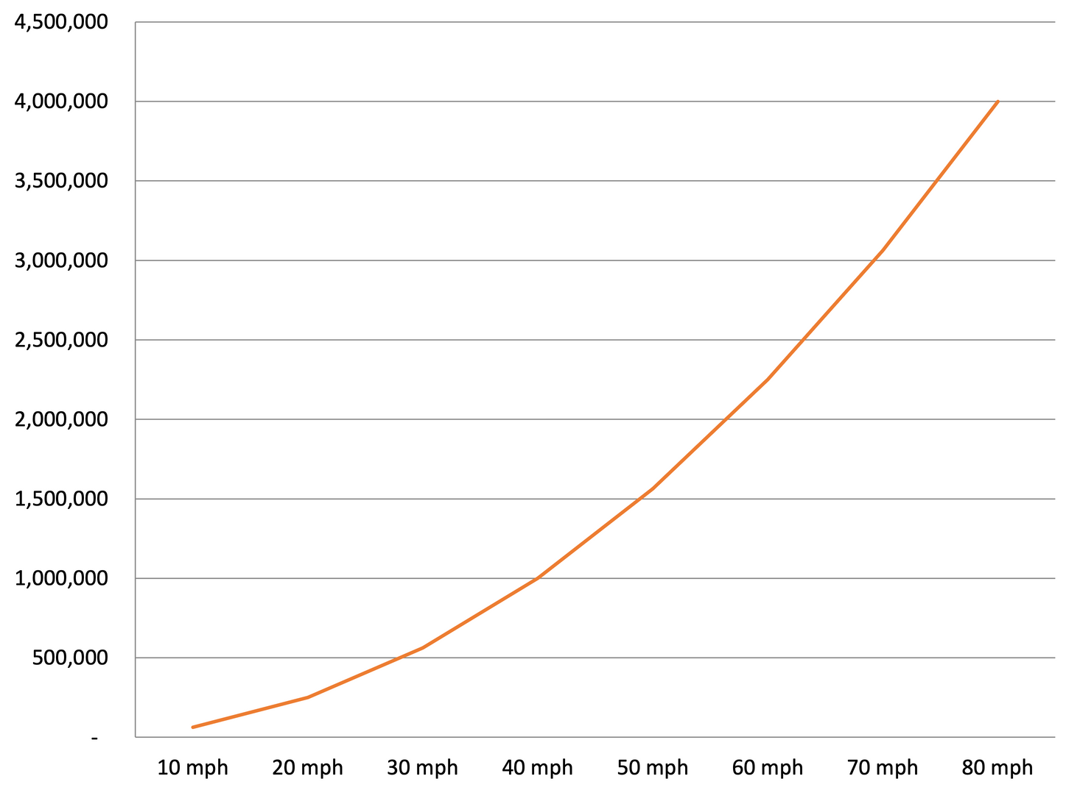
Speed - A little bit of maths…
Kinetic Energy - Vauxhall Astra

Slide 8
As a driver – manage your speed
Your speed must allow you to...
stop safely in the distance you can see to be clear.
Remember that
Higher speed means that you will hit an object with more energy. More energy means more damage.

Slide 9
Distractions
What may distract a driver?
But I can do more than one thing at a time..
I can text and watch tv and drink and talk and…
But can you?

Slide 10
You are about to see a short film
A film about 9 cups (3 yellow, 3 blue, and 3 red) and one ‘Hershey Kiss’ – a Chocolate.
The chocolate will be hidden under one of the cups, then the cups will be moved around.
Your task is to follow the cup that hides the
chocolate from view.
At the end we'll ask you…‘Where is the Chocolate?’

Slide 11
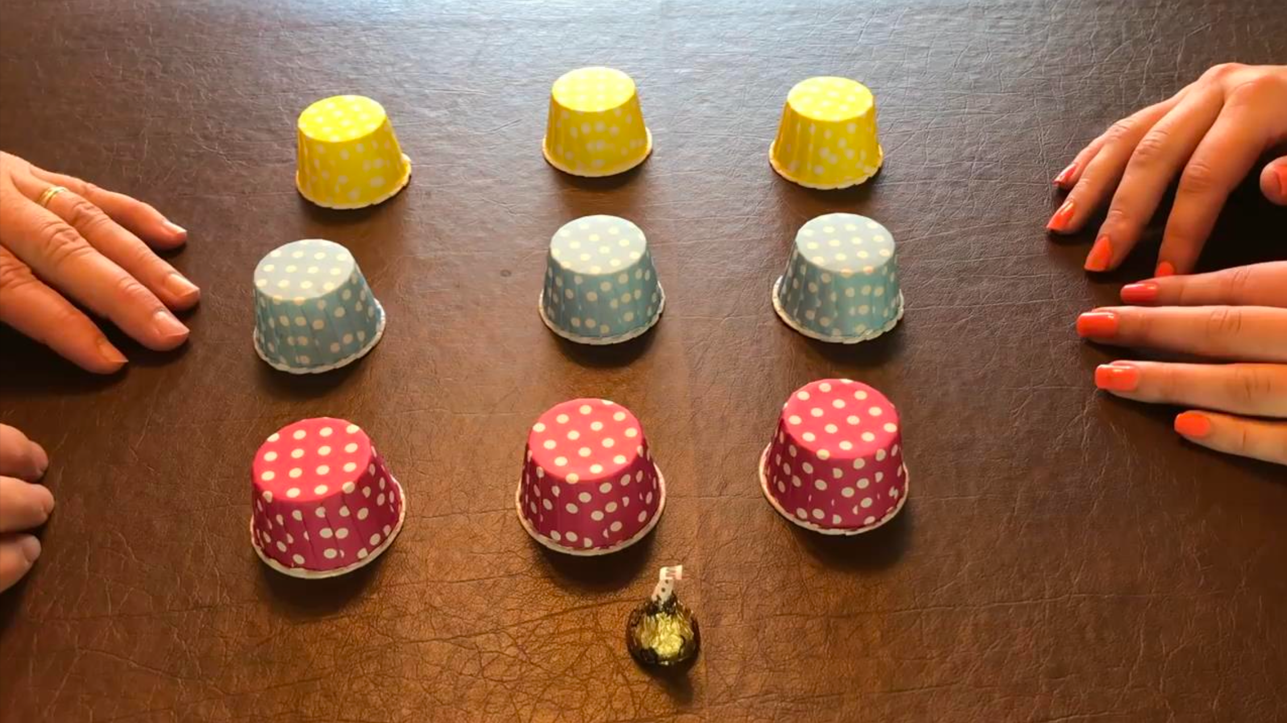


Slide 12
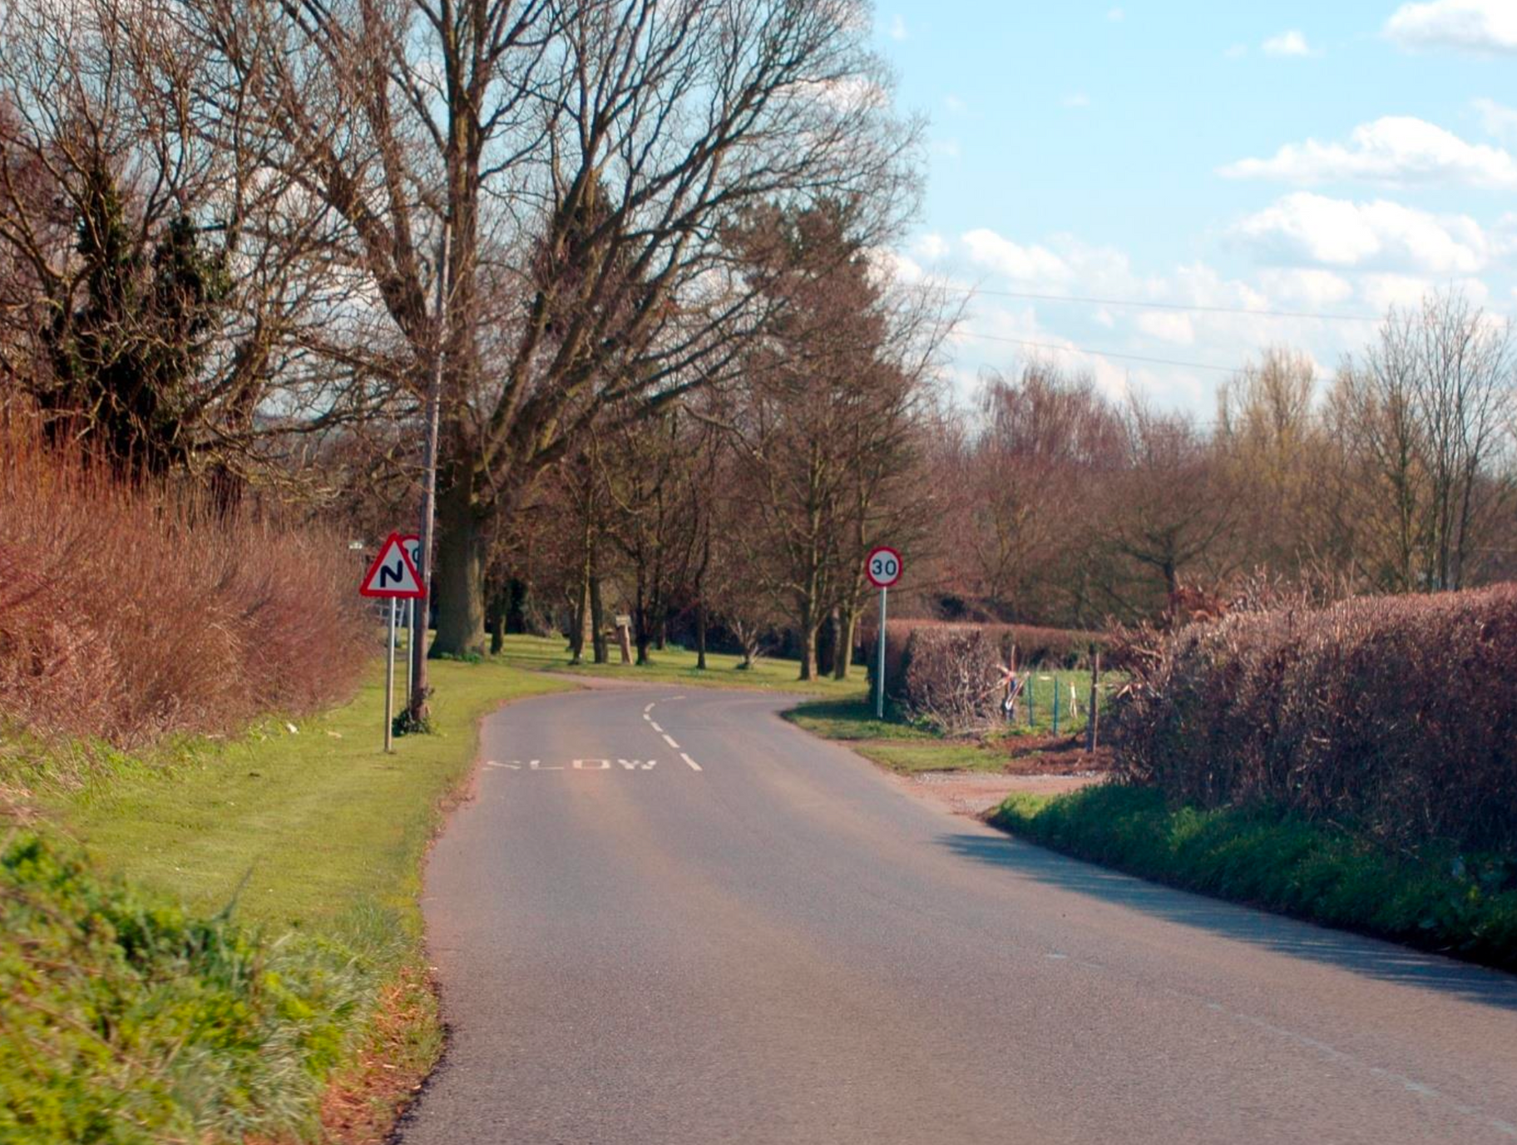

Slide 13
Homework
On your way to/from school, identify 3 hazards for the next lesson

Slide 14
Thank you for listening

